Slide 1

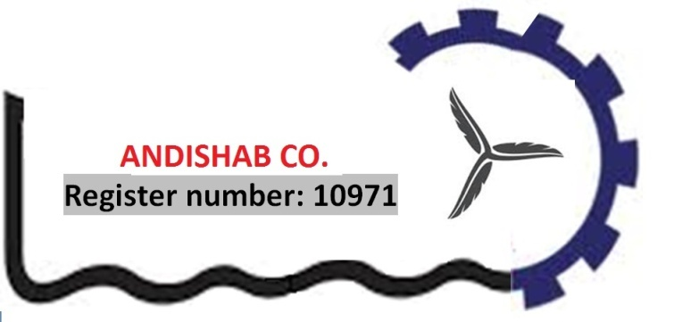


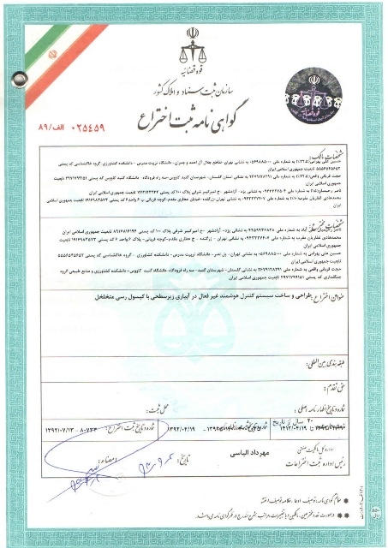


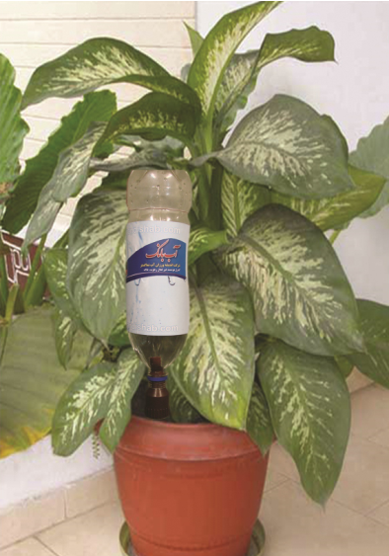


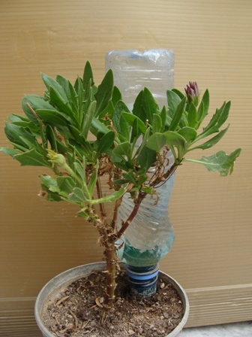
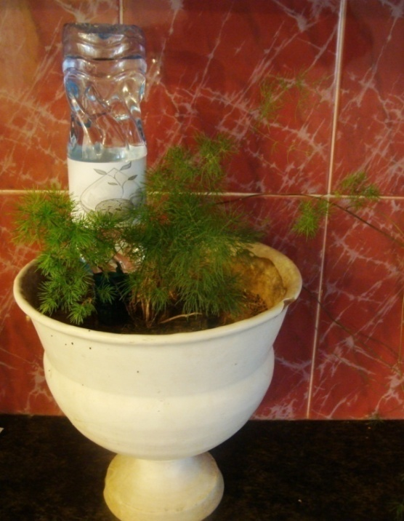
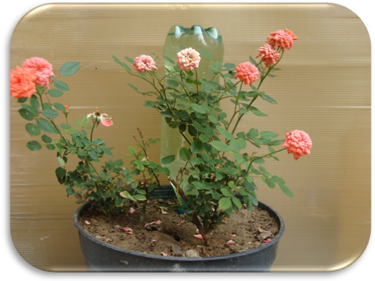
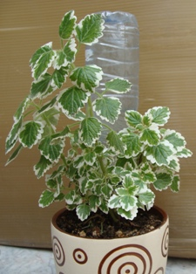
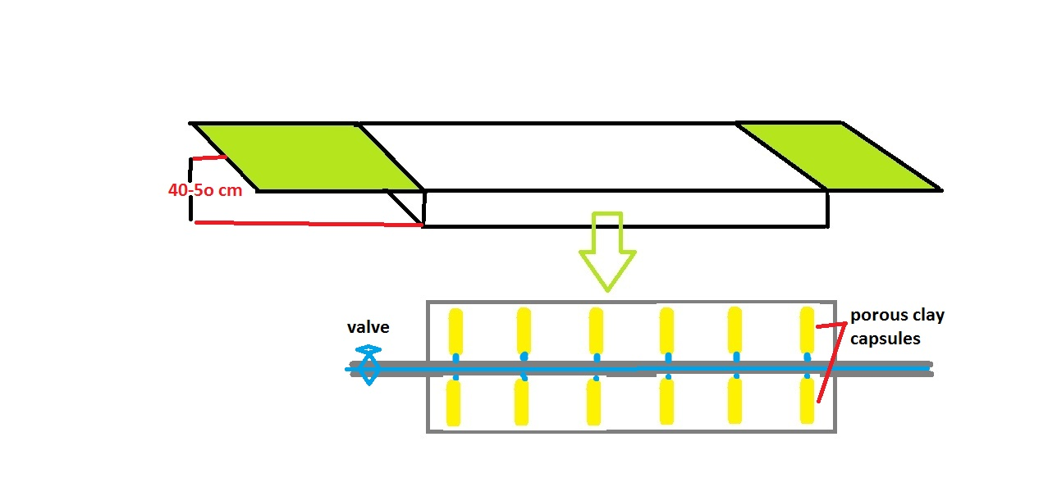
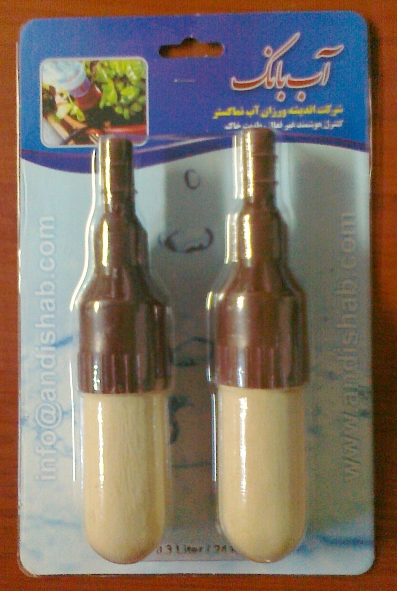
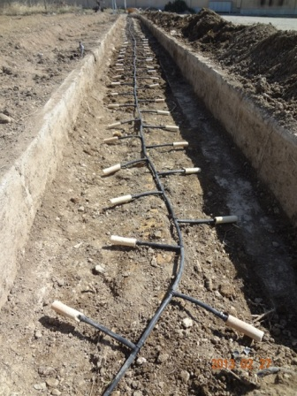
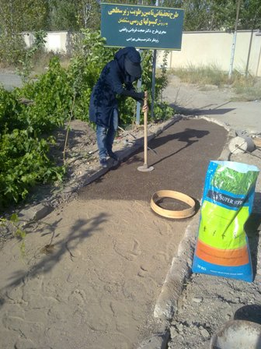
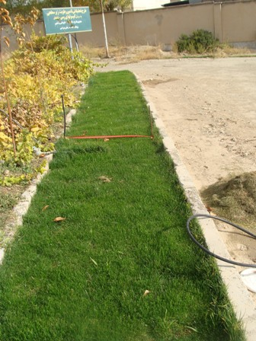
passive intelligent control system in sub-irrigation with AB BANK
80733
(Excellent system for vacation periods)
Iranian International Exhibition Co
www.andishab.com
Made in I. R. IRAN
Original report
Increasing in production of nutrient for human society with increasing water use efficiency using water consumption control by a type of porous clay capsules is called AB BANK
User friendly format of porous clay capsules: AB BANK
( popularized porous clay capsules which everyone can use for plants in apartment living )
Generality
Buried clay pot is traditional irrigation method and is ideal for many farms in the world’s dry land.
clay-pot sub-irrigation has been used for irrigation of fruits and vegetables during the last 1000 years in Iran. But this methods is forgotten or ignored today.
To minimize evaporation and percolation losses, subsurface irrigation systems are being used in many arid and semi arid regions of the world.
AB BANK is an intelligent watering system, enabling the plants to take care of themselves. Watering occurs only in amounts that the plants actually need (this amount is equal to field capacity). This released water in near root zone without electricity or use of an automatic dispenser.
Trademark
AB BANK in pot
Planning for taking care from drought of plant in travelling time. It is ideal for regions affected by drought.
application format for farmers:
this technique will have many applications in agriculture at arid and semi-arid regions
Contact Us
Web : www.andishab.com
Email: info@andishab.com
OR
ghorbani169@yahoo.com
TEL:
+98-912-622-9332
FAX:
+98-17-32121300
AB BANK XL-2-pack Price:
6.50 $

